Slide 1
BLOCKCHAIN FOR RENEWABLE ENERGY TRADING

Slide 2
TEAM INFO:
PS ID : T3PS03
Problem Statement Title : Blockchain for Renewable Energy Trading
Team Name : Tech Army
Team Leader Name : Sanjai J
Institute Name : Sri krishna college of Engineering and Technology

Slide 3
INTRODUCTION:
As the world shifts towards sustainable energy solutions, the need for efficient, transparent, and decentralized energy trading systems has never been more critical.
Our platform leverages blockchain technology to create a secure and reliable marketplace where producers and consumers can trade renewable energy seamlessly. By integrating blockchain, we ensure that every transaction is transparent, traceable, and tamper-proof, fostering trust among all participants.
In this presentation, we will walk you through the key features of our platform, demonstrate how it operates, and discuss the broader impact it can have on the energy market. We believe that this solution not only meets the growing demand for green energy but also paves the way for a decentralized energy future."

Slide 4
WHY THIS PLATFORM:
In today’s rapidly evolving world, the demand for sustainable energy solutions is more critical than ever. However, as the energy landscape shifts, so too must our approach to trading and distributing this valuable resource. Our platform aims to revolutionize the way renewable energy is traded, making it more efficient, transparent, and accessible for all stakeholders.
The current energy trading systems often suffer from inefficiencies, lack of transparency, and limited accessibility, especially for smaller producers and consumers. Our solution addresses these challenges by leveraging cutting-edge digital technologies.

Slide 5
SOLUTION AND APPROACH:
Market Research and Planning:
Identify the needs of renewable energy producers and consumers.
Analyze existing energy trading platforms to understand the market gap and the unique value blockchain integration can bring.
Platform Development:
Frontend: Develop a user-friendly interface with clear navigation, responsive design, and intuitive controls for trading energy.
Backend: Implement secure APIs for handling user data, transactions, and blockchain interactions.
Blockchain: Integrate blockchain technology to record and verify energy transactions, ensuring transparency and trust.
User Authentication and Security:
Implement robust user authentication to protect user data.
Utilize encryption and secure protocols for data transmission

Slide 6
SOLUTION AND APPROACH:
4.Testing and Optimization:
1. Conduct thorough testing of the platform to ensure all functionalities work seamlessly, including trading, payments, and blockchain integration.
2. Optimize the platform for performance and scalability, ensuring it can handle a large number of users and transactions.
5.Launch and Marketing:
1. Launch the platform in stages, starting with a beta version for initial users to gather feedback.
2. Implement marketing strategies targeting renewable energy producers, consumers, and investors to drive adoption.
6.Future Enhancements:
1. Explore the integration of smart contracts to automate trading processes based on predefined conditions.
2. Expand the platform to include other renewable energy sources and possibly integrate IoT devices for real-time energy tracking.

Slide 7
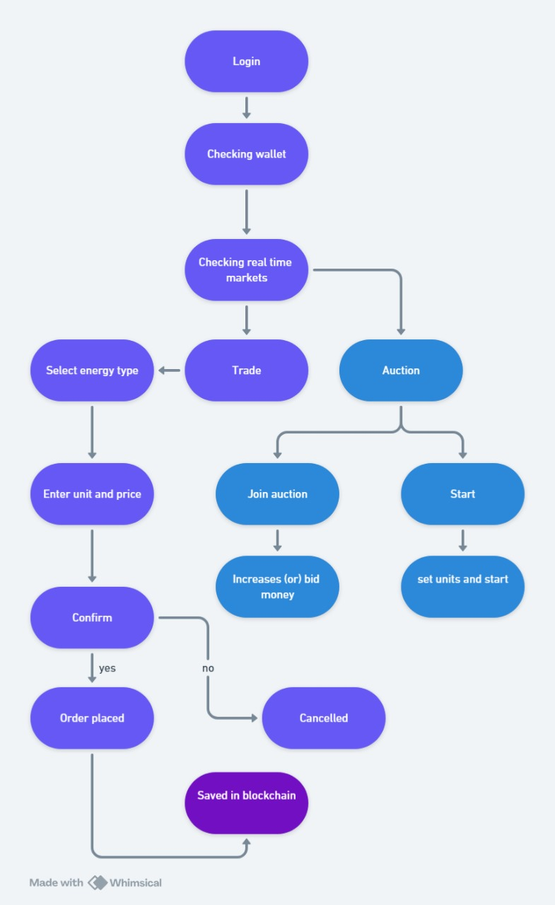
WORK FLOW:

Slide 8
FEATURES:
Decentralized Energy Marketplace:
Our platform enables direct trading between energy producers and consumers without the need for intermediaries.
It supports various types of renewable energy, including solar, wind, and hydro.
Blockchain-Powered Transparency:
Every transaction is recorded on the blockchain, ensuring transparency, immutability, and security.
Participants can easily verify the authenticity of trades and track the flow of energy.
Smart Contracts for Automation:
Smart contracts automate the execution of trades based on predefined conditions, reducing the need for manual intervention.
This ensures quick, reliable, and tamper-proof transactions.

Slide 9
FEATURES:
Real-Time Market Data:
Users can access up-to-date information on energy prices, available volumes, and market trends.
The platform provides insights into the current supply and demand, helping users make informed decisions.
User-Friendly Interface:
The platform features an intuitive interface for easy navigation, making it accessible to users with varying levels of technical expertise.
Both the trading and account management processes are streamlined for convenience

Slide 10
THE IMPLEMENTATION OF BLOCKCHAIN
The block which contains the information of the transaction that has been done by user
each user have separate block and information
If the user/hacker tries to trade using fake money ,the serve will check the block and if the money is not in the log the transaction will be denied

Slide 11
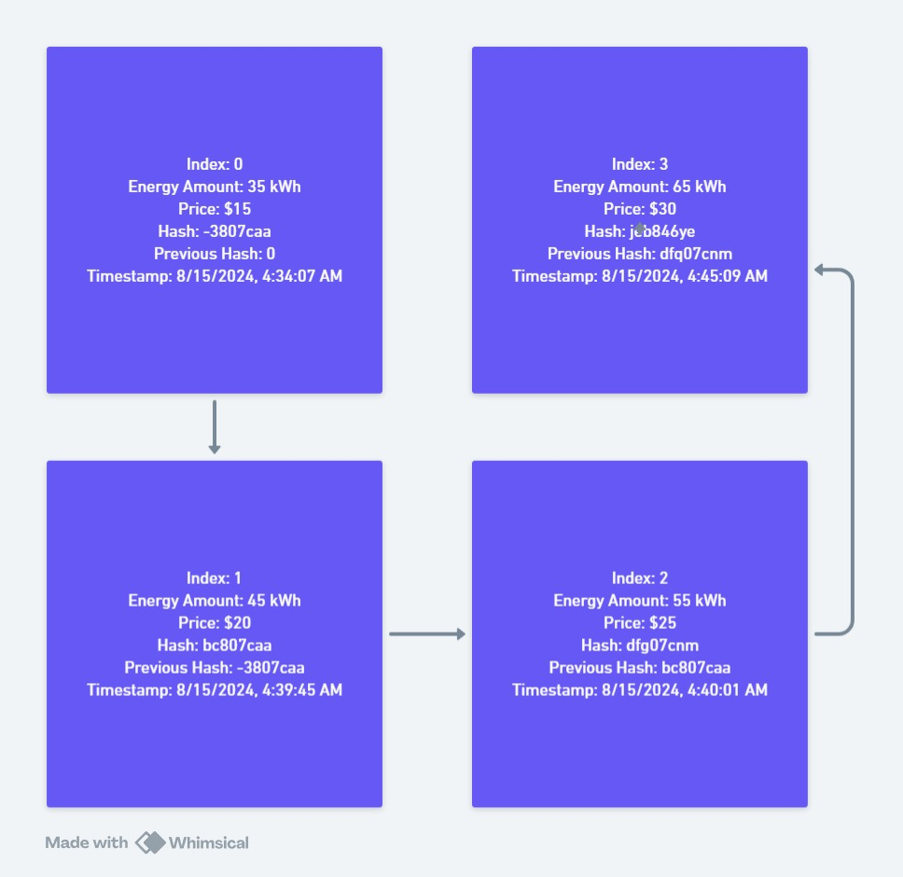
THE IMPLEMENTATION OF BLOCKCHAIN

Slide 12
TEAM MEMBER INFO:
Team Leader Name: SANJAI J
Branch: BE Stream: CSE( Cyber Security) Year:II
Team Member 1 Name: MANISHWAR S
Branch: BE Stream: CSE(Cyber Security) Year:II
Team Member 2 Name: SURESH KUMAR S
Branch: BE Stream: CSE(Cyber Security ) Year: II
Team Member 3 Name: SHRI HARI S
Branch: BE Stream: CSE(Cyber Security) Year: II

Slide 13
THANK YOU
WORK BY :
TECH ARMY

